Slide 1



CORHIO By the Numbers
Last updated 9/28/2015
49
Hospitals Connected
(10 more underway)
2,700+
Providers Connected
(7,600+ total users)
4,000,000+
Patients in the
Community Health Record

Slide 2
CORHIO HIE Network Growth
Statistics through July 20, 2015
More than 500 additional providers
in queue to be connected

Slide 3
Hospitals - Connected
Last updated 9/28/2015
Banner Health System (8/2012)
Banner Fort Collins Medical Center (4/2015)
East Morgan County Hospital
McKee Medical Center
Northern Colorado Medical Center
Sterling Regional MedCenter
HealthONE Health System (12/2014)
North Suburban Medical Center
Presbyterian/St. Luke’s Medical Center
Rocky Mountain Hospital for Children
Rose Medical Center
Sky Ridge Medical Center
Spalding Rehabilitation Hospital
Swedish Medical Center
The Medical Center of Aurora
Centura Health System (10/2011)
Avista Adventist Hospital
Castle Rock Adventist Hospital
Littleton Adventist Hospital
Mercy Regional Medical Center
OrthoColorado Hospital
Parker Adventist Hospital
Penrose Hospital
Porter Adventist Hospital
St. Anthony Hospital
St. Anthony North Hospital
St. Anthony Summit Medical Center
St. Catherine’s Hospital, Kansas (09/2014)
St. Francis Medical Center
St. Mary-Corwin Hospital
St. Thomas More Hospital
Connection dates in parentheses

Slide 4
Hospitals - Connected
Last updated 9/28/2015
SCL Health System (Exempla) (5/2014)
Good Samaritan Medical Center
Lutheran Medical Center
Saint Joseph Hospital
University of Colorado Health System
Medical Center of the Rockies (12/2011)
Memorial Hospital Central (7/2012)
Memorial Hospital North (7/2012)
Poudre Valley Hospital (12/2011)
University of Colorado Hospital (6/2013)
Independent Hospitals
Boulder Community Hospital (2/2011)
Boulder Community Foothills Hospital (2/2011)
Children's Hospital Colorado (12/2012)
(new South Campus added 1/2014)
Conejos County Hospital (9/2014)
Craig Hospital (receiving data only) (7/2013)
Estes Park Medical Center (8/2014)
Evans Army Community Hospital (12/2013)
Longmont United Hospital (12/2011)
Mt. San Rafael Hospital (8/2015)
Parkview Medical Center (4/2012)
Prowers Medical Center (12/2014)
San Luis Valley Regional Medical Ctr (8/2011)
Connection dates in parentheses

Slide 5
Hospitals - Under Agreement
Last updated 9/28/2015
Independent Hospitals
Animas Surgical Hospital
Arkansas Valley Regional Medical Center
Colorado Plains Medical Center
Denver Health & Hospital Authority
Kit Carson County Memorial Hospital
Melissa Memorial Hospital
Pagosa Springs Medical Center
Rio Grande Regional Hospital
Spanish Peaks Regional Health Center
Southwest Memorial Hospital
Vail Valley Medical Center

Slide 6
Labs Participating in HIE
Last updated 9/28/2015
Under Agreement:
  Cedar Diagnostics
  Gastroenterology of the Rockies (in-house pathology lab)
  MetroPath
  UniPath
Connected to HIE:
  Colorado Lab Services
  LabCorp
  Quest Diagnostics
  (9Health Fair)
    Schryver Medical

Slide 7
CORHIO Dashboard
Last updated 9/28/2015
 | Live/Completed | In Development | In Queue
State/HIE | HCPF: Outreach for Medicaid EHR Incentive Program - ongoing HIE: CORHIO data to QHN; HISP to HISP connections with Surescripts, Kansas HIE (KHIN) and Cerner CDPHE: Immunizations (CIIS), Newborn Screening (results delivery), Electronic Lab Reporting, Syndromic Surveillance (CDC) | HCPF: Accountable Care Collaborative and Regional Care Collaborative Organizations, Medicaid expansion, eReferral/eConsult, TEFT PHR for Medicaid clients, State Innovation Model grant HIE: Bi-directional connection with QHN | CDPHE: Newborn Screening (orders), Cancer Registry, and e-Referrals for Colorado Tobacco QuitLine (w/Denver Public Health), public health services added with federal Medicaid expansions
Hospitals | 49 hospitals connected to HIE | 2 hospitals connecting to HIE | 8 hospitals under agreement for HIE
Doctors/ Providers | 2,706 providers connected to HIE | 61 PatientCare 360 or EHR Integration projects in development with providers | 198 PatientCare 360 or EHR Integration projects in queue with providers
Behavioral Health/Labs/ Long-Term Care | 132 long-term care, skilled nursing, home health and hospice facilities 39 behavioral health centers 4 labs | 1 imaging center 2 labs | 5 long-term care facilities 2 labs Colo. Telehealth Network (medical images)
Payers/ACOs | CCMCN/CACHIE Colorado Access Colorado HealthOp HCPF Kaiser Permanente Physician Health Partners (PHP) | Anthem CHP ICHP Rocky Mountain Health Plans | Aetna Humana United-Secure Horizons
Consumers | 4,000,000+ unique patients in the HIE 9Health Fair | PHR/patient portal projects

Slide 8
Last updated 9/28/2015
About CORHIO
CORHIO is a nonprofit, public-private partnership that is improving health care for all Coloradans through health information technology and the implementation of electronic health information exchange (HIE).
CORHIO manages and maintains the technology infrastructure that supports secure, efficient clinical information sharing among health care providers across Colorado.
Electronic Health Record (EHR) Connectivity Status:
Green: Connected to CORHIO
AllMeds
Allscripts Pro
Allscripts TouchWorks
Amazing Charts
Aprima
AthenaHealth
CareTracker
Cerner Millennium/ PowerNotes
CoCentrix
(formerly UNI/CARE)
eClinicalWorks
e-MDs
Elekta Mosaiq
Epic
GE Centricity
Greenway
HealthFusion
HealthTronics/UroChart
McKesson Horizon
McKesson Practice Partner
MEDHOST
Meditech
MicroMD
ModuleMD
Netsmart
NextGen
Office Practicum
Red Planet
Sevocity
SRSoft/SRS EHR
Vitera/Intergy
Improving Health Care Quality
HIE improves health care providers’ ability to administer timely and effective patient care with more accurate, up-to-date patient information at the point-of-care
Reducing Costs
HIE reduces the number of duplicate tests performed on patients, lowering costs and improving patient satisfaction
HIE saves lives in emergency situations, giving medical professionals information they need at their fingertips
For providers, HIE reduces administrative costs including those associated with printing, faxing, mailing and overall management of patient medical records
Yellow: In process to connect to CORHIO or verified as being able to connect
Answers on Demand
CareCloud
CureMD
MacPractice
MediTab
Point Click Care
Pulse Systems
Red: Unlikely to connect to CORHIO in the near term
Practice Fusion

Slide 9
CORHIO 2.0: Roadmap Concepts and Solutions

Slide 10
CORHIO 2.0 Architecture Diagram
MEDICITY
CORHIO 2.0
Hospital Systems
Practice EHR
Practice EHR
Practice EHR
Practice EHR
Practice EHR
Web Services
C-CDA
HL-7
HL-7
HL-7
C-CDA
IHE
ODBC
Crimson Care Analytics
Affinity GateWay
Payor Gateway
IntegrationI Engine
Rules Engine
Normalization Engine
HCPF
Nexus Engines
HL-7
NOVO
Rendezvous
CCMCN
CDR’’’
CDR’
CDR’’
iNexx
Operations
SSO
Staging
PatientCare360
Portal
Practice EHR
Staging
CORHIO Data Warehouse

Slide 11
Solutions: Patient Event Notifications
What is it?
  This service allows a participant to be notified when one or more of their patients/members is admitted or discharged from a CORHIO-participating hospital or emergency room.
Delivery
  Batch Delivery: pdf or csv
  Real Time HL7 (eg into care coordination tool)
Current Participants: DoD, CHP, UPI, HCPF, KP, Colorado Access, CCMCN
Intended Use
  ACO / Risk Barring Arrangements
  Hospital Care Coordinators
  PCMH (future)
Data Services
Patient Event Notifications
Clinical Event Notifications
More coming soon
More coming soon

Slide 12
Solutions: Clinical Event Notifications
What is it?
  This service allows a participant receive notification of occurrence with values for targeted clinical conditions and procedures on one or more of their patients/members.
Status: In Development
  Scoping Dependencies and Requirements
Current Participants: Pilot
  CHP Pilot (A1C and Post Partum)
Intended Use
  ACO / Risk Barring Arrangements
  Hospital Care Coordinators
  PCMH (future)
Data Services
Patient Event Notifications
Clinical Event Notifications
More coming soon
More coming soon

Slide 13
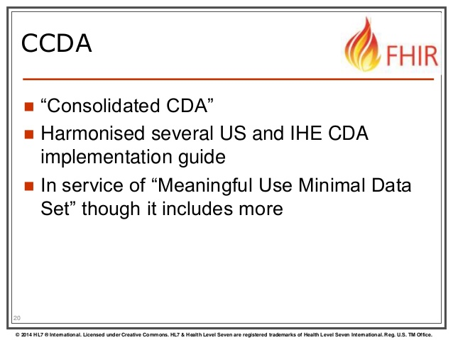
Ambulatory Data Acquisition (C-CDA
What is it?
  Installing tools and in building infrastructure to accept and parse data from ambulatory practices to be integrated into the patients health record.
Learnings
  And you thought the hosptital EHR’s presented barriers!
  Making progress with dedicated resources focused on breaking down barriers.
  Legislative action…Data Blocking
Next Steps
  Continue to move forward with state Medicaid practices

